Slide 1
Vicuna FPU Design Survey
Driving Innovations™
Eric Chen
2018-01-26

Slide 2
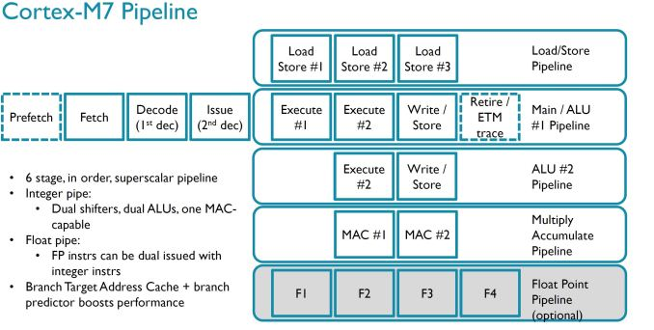
Cortex-M7 FPU
T:\RD-VLSI\Marketing_Material\Competitive_Analysis\ARM Cortex-M7
2014-0923 - Cortex-M7 Launches Embedded, IoT and Wearables.docx

Slide 3
Vicuna FPU Design Survey
Reference
Eng. Walaa Abd El Aziz Ibrahim “Binary Floating Point Fused Multiply Add Unit,” A Thesis Submitted to the Faculty of engineering at Cairo University Requirement for the Degree of MASTER, 2012
Lang, T., and Bruguera, J., “Floating-Point Fused Multiply-Add with Reduced Latency,” IEEE Transactions on Computers, vol. 53, no. 8, August 2004, Pages: 42 – 51.

Slide 4
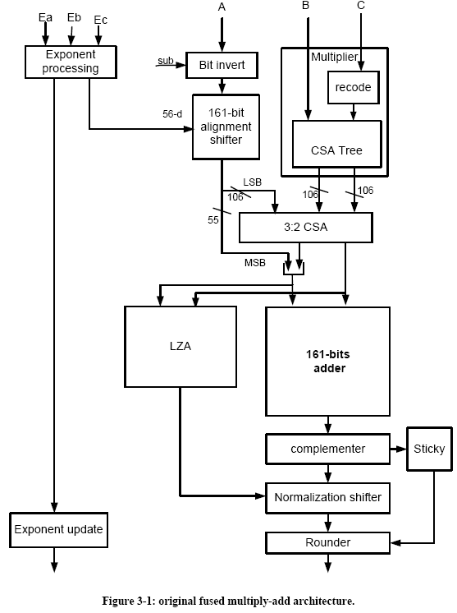
Original FMA
IBM RS/6000, 1990
T. Lang: reduce latency by combining adder/rounder
Normalization should be done before rounding
LZA overlap with Normalization

Slide 5
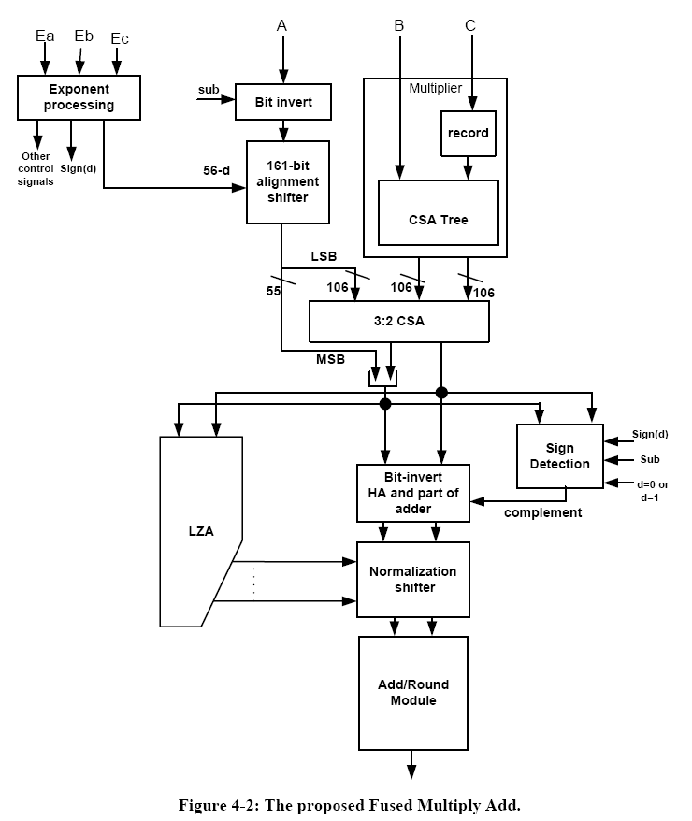
FPU Pipeline
FMA: A+(BxC)
±A+(BxC)
Target:
Vicuna 1.2GHz
@tcbn28hpcbwp12t35p140wc
F1
L1~L5
L6~L7
F2
F3
Adders
F4

Slide 6
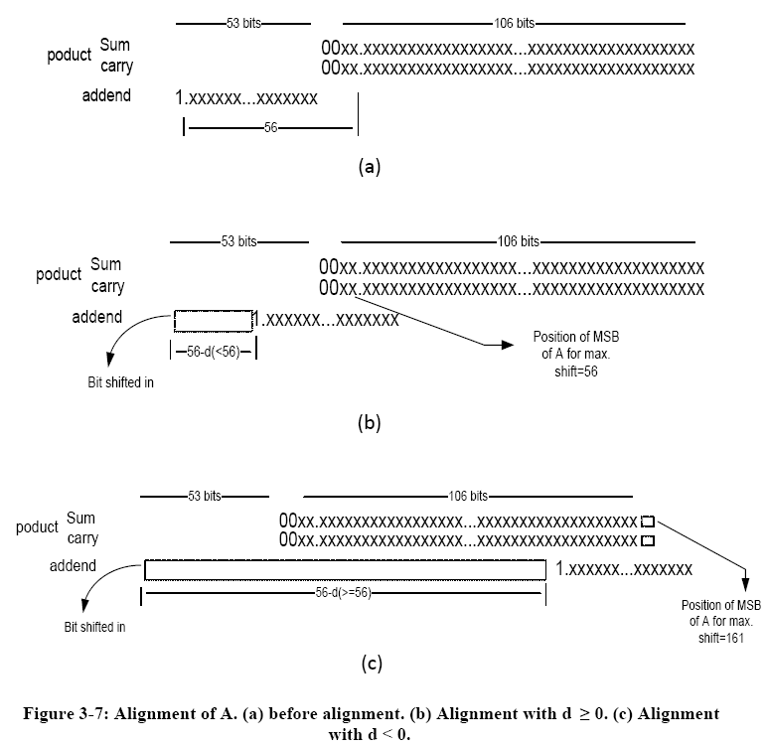

Alignment Shift
d=E_{a}-(E_{b}+E_{c})
Pre left shift A by 56bit
only right shifter needed
(b) d≧0 (i.e E_{a}>(E_{b}+E_{c})) d≧0: 56-d < 56
(c) d＜0: 56-d > 56

Slide 7
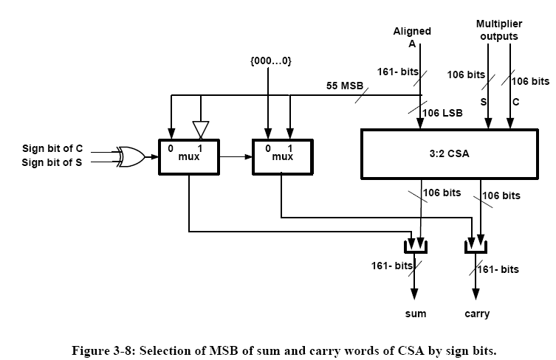
Using 106 bits (3,2) CSA
Or using 161-bit CSA
No timing issue
A’
A’
A’
+
+
{C,S}={0,0} : + {C,S}={0,1/1,0} : -
{1,1} : N/A
{0,0}: A’ ➔ sum, 0 ➔ carry
Otherwise: ~A’ ➔ sum, 2A’ ➔ carry

Slide 8
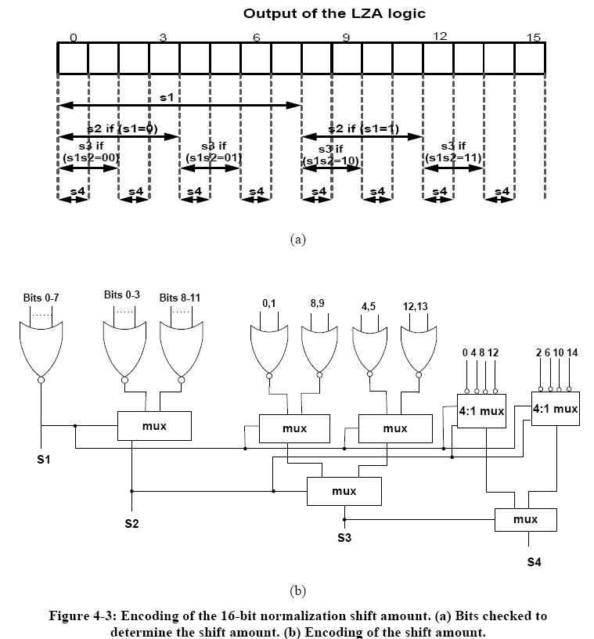
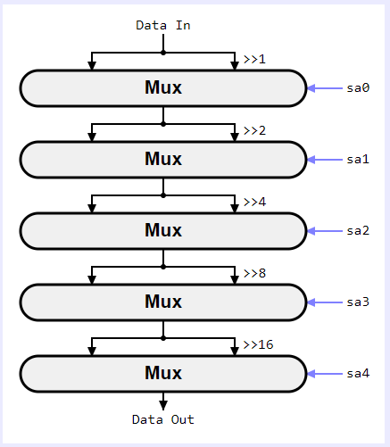
Leading One Detection
GW FPU using CASE to generate shift amount
Overlap with Normalization
S1 generated first, stage 1 of Normalization can be kicked off
S2 generated by a MUX, overlapped with MUX of Normalization stage 2.
Error correction of LZA is corrected at F4 add/round stage

Slide 9
Sign Detection
When result of CSA is negative, complement the output of CSA
Negative when following conditions are true:
The result can be negative only for effective subtraction.
Only d≧0 (E_{a}>(E_{b}+E_{c})), can be negative
When d≧2, the result is always negative.
For d=0 or d=1, the result can be positive/negative.
depends on the overflow of multiply result and contain values
Shift amount = 56 or 55 ➔ at least 55 MSB is sign ext.
Only 109-bit magnitude comparator is needed
7 stages are needed

Slide 10
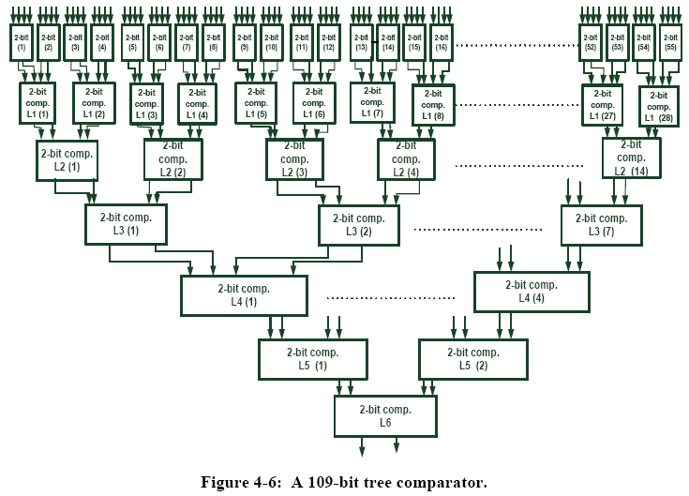
109 Bit Tree Comparator
Or use a simple “>” comparator

Slide 11
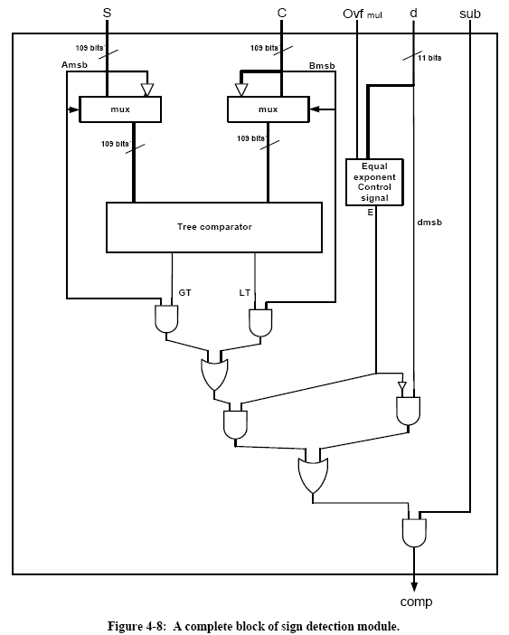
Sign Detection

Slide 12
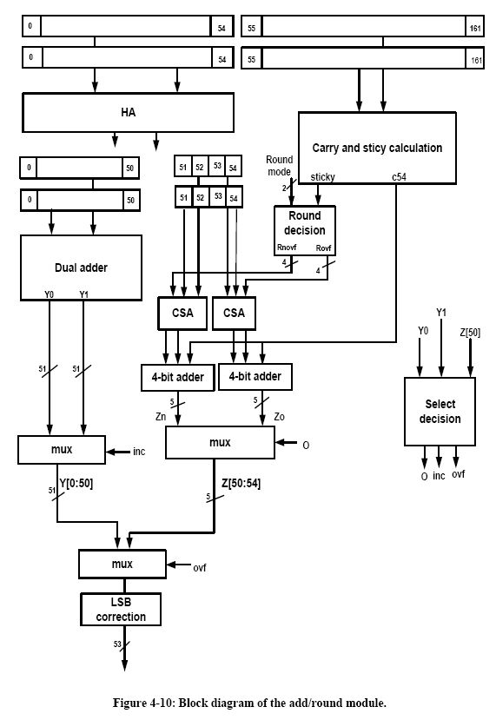
Add/Round Module
Move 51 bit dual adder to F3
Pipeline flop is the same
LSB correction for Round-to-nearest-even
F3
F4

Slide 13
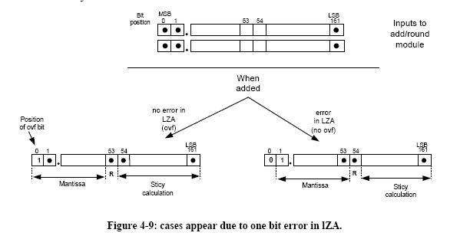
One bit error of LZA
Round bit at [53] or [54] due to LZA error

Slide 14

Thank You!
www.andestech.com

Slide 15
Thank You!

Slide 16
Register File
frs0_index
I2
frs1_index
frs2_index
GW FPU
forwarding_data
Special value
Detection
Unpacking
F1
mul_result
Exp & Signed
Alignment
MUL/DS
ieu_fpu_rs_data_f1
F2
MUL/DS
Special value
Exp adjust
Determine signed
fpu_iru _exception_f2
CSA
F3
LZA
CPA
ieu_fpu_rd_data_f3
Exp adjust
Normalization and rounding
Packing

Slide 17
GW FPU Function Unit timing
 | Frequency (MHz) | Period (ns) | Area (Kgates) | Uncertainty (> period*0.3)
53-bit adder | 1620 | 0.617 |  | 0.3
110-bit adder | 1531 | 0.653 |  | 0.3
MUL unit original | 987 | 1.013 |  | 0.3
MUL flop L5 | 1179 | 0.848 | 54.6kK | 0.252
MUL flop L4 | 1428 | 0.700 | 54.07K | 0.215
DSU original | 1098 | 0.910 | 11.48K | 0.3

Slide 18
A7 FPU instruction cycle
VFP instructions | Issue cycles | Result latency
VMOV.F32 Sd, Sm | 1 | 4
VMOV.F64 Dd, Dm | 1 | 4
VNEG.F32 Sd, Sm | 1 | 4
VNEG.F64 Dd, Dm | 1 | 4
VABS.F32 Sd, Sm | 1 | 4
VABS.F64 Dd, Dm | 1 | 4
VADD.F32 Sd, Sn, Sm | 1 | 4
VADD.F64 Dd, Dn, Dm | 1 | 4
VMUL.F32 Sd, Sn, Sm | 1 | 4
VMUL.F64 Dd, Dn, Dm | 4 | 7
VMLA.F32 Sd, Sn, Sm | 1 | 8¹
VMLA.F64 Dd, Dn, Dm | 4 | 11²
VFMA.F32 Sd, Sn, Sm | 1 | 8¹
VFMA.F64 Dd, Dn, Dm | 5 | 8²
VDIV.F32 Sd, Sn, Sm | 15 | 18
VDIV.F64 Dd, Dn, Dm | 29 | 32
VSQRT.F32 Sd, Sm | 14 | 17
VSQRT.F64 Dd, Dm | 28 | 31
VCVT.F32.F64 Sd, Dm | 1 | 4
VCVT.F64.F32 Dd, Sm | 1 | 4
VCVT.F32.S32 Sd, Sm | 1 | 4
VCVT.F64.S32 Dd, Sm | 1 | 4
VCVT.S32.F32 Sd, Sm | 1 | 4
VCVT.S32.F64 Sd, Dm | 1 | 4
VCVT.F32.S32 Sd, Sd, #fbits | 1 | 4
VCVT.F64.S32 Dd, Dd, #fbits | 1 | 4
VCVT.S32.F32 Sd, Sd, #fbits | 1 | 4
VCVT.S32.F64 Dd, Dd, #fbits | 1 | 4
¹ 5 cycles with dependency only on accumulator. ² 8 cycles with dependency only on accumulator.
MAC instr
https://hardwarebug.org/2014/05/15/cortex-a7-instruction-cycle-timings/

Slide 19
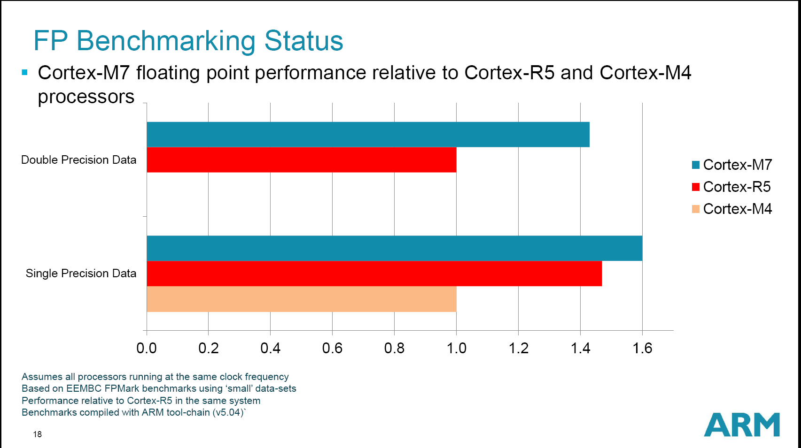

Slide 20
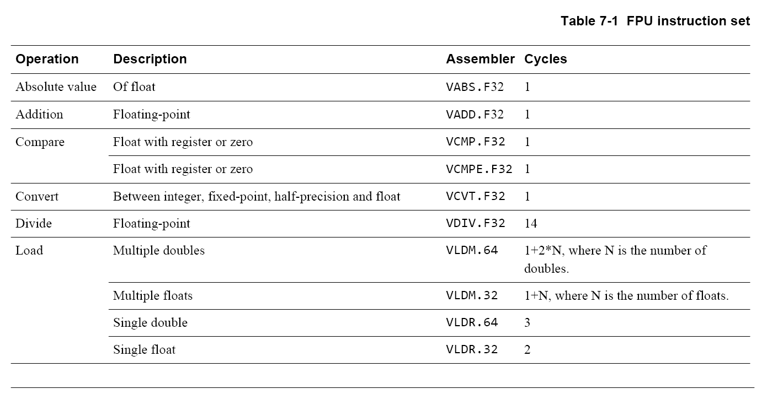
ARM M4 FPU Instr. and Cycles
M4 only support single precision FP

Slide 21
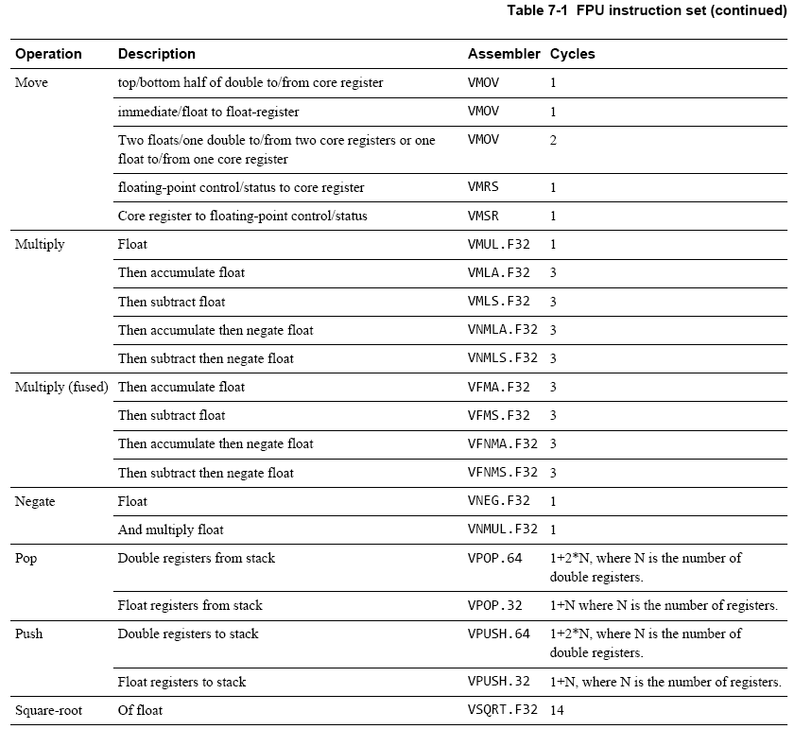
M4 Single
FP

Slide 22
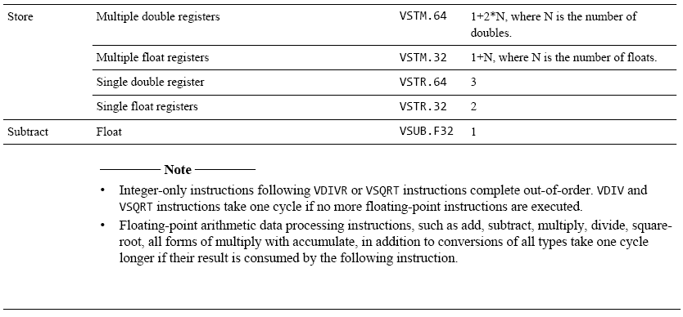
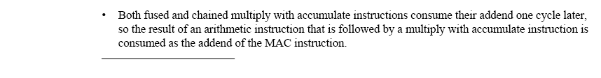
M4 Single FP

Slide 23
